Slide 1
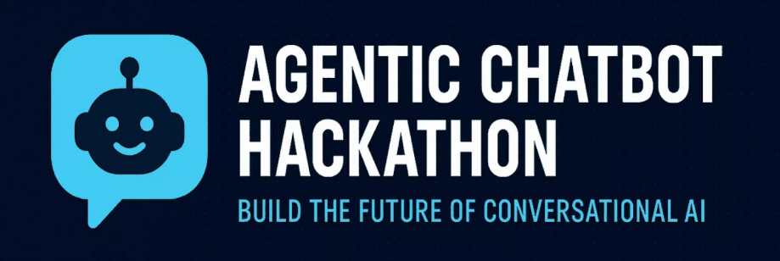



Financial Inclusion for Women — AI Solutions for Economic Empowerment and Financial Literacy
Empowering women to save for the future
Team ph590369
HARINI.P
HEMACHANDRAN.K
HARISH.R

Slide 2

PROBLEM STATEMENT
Many women lack access to formal banking and finance tools. Financial literacy is low, especially in rural areas. Language, tech skills, and trust gaps create barriers. Existing systems aren’t designed for women users.
Financial tools exist — but they speak a language many women can’t access. It's time to bridge that gap with empathy, AI, and inclusion.

Slide 3

EXISTING SOLUTIONS
Financial independence is empowering, and I am dedicated to growing my wealth through smart investments and strategic saving.
AI-Powered Financial Advisor for Rural India.
Grameen Foundation's Digital Connections
Axiata Group Berhad's Digital Banking Services
BBVA Microfinance Foundation's Financial Education
Virtual Remittance Gateway's Mobile Wallets
Banking Reserves and Plans for Homemakers
NGO’S Funding for Narisena
Microfinance – Limited reach and no tech integration.

Slide 4

PROPOSED SOLUTION
👉 How our Solution Differs from the existing ones??
AI-based web application for financial literacy and guidance. (Our Project BudgetIQ)
Chatbot (Alpha AI) to assist with savings, budgeting, and credit.
Voice and local language support for easy access.
Connects with UPI, digital wallets, and microfinance options.
Analytical Dashboard to enhance your budgets visually.
Delta(Our AI predictive bot) to Predict and analyze unexpected events that consumes your monthy budget. (Eg: Hospital & Medication)

Slide 5
A woman needs to be in control of her own finances.
Being in control of my financial well-being empowers me to make informed decisions and plan for a secure future.

Slide 6

FEASIBILITY OF PROJECT
Uses existing AI and mobile tech. Can be built using open-source tools.
Low-cost, scalable, and smartphone-friendly. Strong scope for partnerships with banks, NGOs, and govt.
Built using existing, affordable AI and web technologies.
Works on low-end smartphones with offline support.
Easy to scale through cloud platforms.

Slide 7

I make sure to spend within my means.
It's important to be mindful of our finances and to live within our means.

Slide 8
NOVELTY OF PROJECT
Community-Based Learning Circles:
AI groups women with similar financial goals to encourages peer learning, motivation, and local problem solving.
Story-Based Learning:
Modules Real-life inspired financial stories or dramas to teach concepts.
Women-Centric Emergency Fund Alert:
Based on spending patterns, the AI suggests creating emergency funds for health, family issues likewise.
Multi-Currency Convertor for Investments: Acts as a Calculator for Domestic and international purpose

Slide 9
FINANCIAL INDEPENDENCE IS ACHIEVED WITH FINACIAL LITERACY
Financial independence is empowering, and I am dedicated to growing my wealth through smart investments and strategic saving.

Slide 10

LITERATURE REVIEW
S.NO | PAPER NAME | AUTHOR NAME | YEAR OF PUBLICATION | GAPS IN RESEARCH WE FOUND
1. | Digital finance, Bargaining Power and Gender Wage Gap | Qing Guo, Siyu Chen, Xiangquan Zeng | 2024 | Demonstrates digital finance narrowing wage gap in China; lacks exploration of AI-specific interventions and fintech usability insights
2. | Digital Financial Literacy’s Role in Women’s Financial Inclusion (Emerald Insight) | Emerald Chen, James Richard | 2022 | Emerald Insight Provides regression-based link between digital literacy and formal banking across 144 countries; lacks country-specific case studies or AI-mechanism details
3. | Role of Fintech in Financial Inclusion Among Working Women in India | Pooja Gupta et al | 2024 | Library Progress Int. Highlights fintech access in India; doesn’t cover AI-driven models, nor long-term impact or scalability
4. | Gender-Inclusive Development through Fintech: A Cross‑Country Digital Inclusion Index | Sabyasachi Tripathi & Meenakshi Rajeev | 2023 | Builds a gender digital finance index across 109 countries; gaps include absence of AI model evaluation and user-experience studies
5. | AI for Advancing Women’s Data & Financial Services: Insights from Standard Chartered’s SocialAI ModelFlavia Polles | Ramachandran Trivedi & Shrishti Gupta | 2025 | We‑Fi Case Study Details AI model to tag client gender; lacks info on outcomes, adoption barriers, and model fairness

Slide 11
LITERATURE REVIEW
S.NO | PAPER NAME | AUTHOR NAME | YEAR OF PUBLICATION | GAPS IN RESEARCH WE FOUND
6. | Harnessing AI for Personalized Financial Coaching: A Pathway to Financial Inclusion and Empowerment for Women in the United States | Adesola O. Adelaja | 2024 | Focused on U.S.; lacks real-world application in low-income or developing nations.
7. | The Gendered Algorithm: Navigating Financial Inclusion & Equity in AI-facilitated Access to Credit | Genevieve Smith | 2025 | Identifies gender bias in AI models; no concrete mitigation techniques proposed.
8. | Designing Multi-modal Conversational AI Financial Systems: Sensitive Values of Women Entrepreneurs in India | Harini Srivatsav | 2024 | Good design practices; lacks quantitative validation or deployment results.
9. | Financial Inclusion of Vulnerable Sectors with a Gender Perspective: Risk Analysis Model with Artificial Intelligence Various (Springer) | G. Srividhya | 2021 | Theoretical framework only; lacks datasets, model testing, or scalability evidence.
10. | Leveraging AI to Enhance Financial Inclusion for Women | Meghana Yadav & Dupesh Gowrav | 2023 | Focuses on AI risk modeling; lacks real-world testing and ethical safeguards.

Slide 12
I am confident in my ability to achieve my financial dreams.
This is through staying proactive and staying informed about the financial market.

Slide 13

TECHSTACKS TO BE USED
FRONTEND: HTML, CSS, Bootstrap, JAVASCRIPT, React and Angular.
BACKEND: JAVA (SpringBoard) and node.js
DATABASE: MongoDB
AI & NLP: Python, Transformers, SpaCy, Gemini (OpenAI API),NLP ToolKit
Cloud & Hosting (Future directions): Microsoft Azure
Integration: UPI API’s, Voice Assistance and Chatbot for doubt Clearance

Slide 14
I am conscious of my own expenses.
This allows me to make informed decisions about where our money goes, ensuring that we can save for the future and enjoy a more secure financial position.

Slide 15
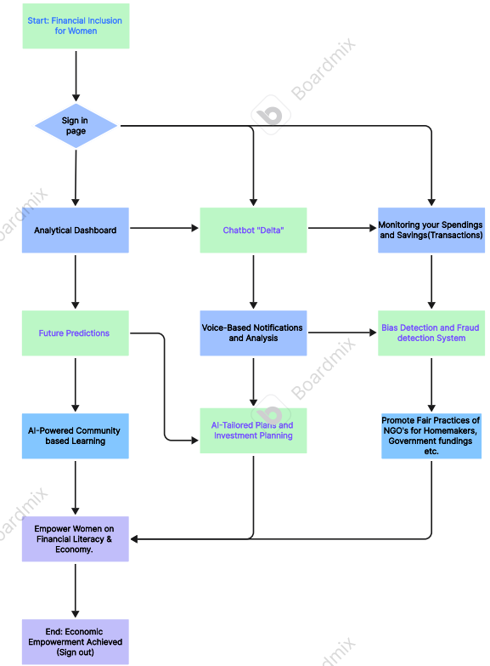
OUR TO BE ARCHITECTURE DIAGRAM

Slide 16

I invest on my future.

Slide 17
CONCLUSION
Our project depicts a promising picture of how AI and digital technologies are transforming women’s access to financial resources, knowledge, and empowerment opportunities.
“BUDGETIQ” aims to bridge the financial gap for women using AI-driven, accessible, and personalized solutions. By combining technology with empathy, we empower women to take control of their finances, make informed decisions, and achieve economic independence.

Slide 18

I believe in the power of investing in oneself and preparing for the future.
By dedicating time and effort to learning, self-improvement, and setting goals, we lay the foundation for a bright and prosperous future.

Slide 19
Remember, the greatest investment you can make is in yourself.
Thank you for your Time!!

